Slide 1


Dr. N.G.P. INSTITUTE OF TECHNOLOGY (An Autonomous Institution) Approved by AICTE, New Delhi & Affiliated to Anna University, Chennai. Recognized by UGC & Accredited by NAAC with A+ and NBA [BME, CSE, ECE, EEE & Mechanical] Coimbatore- 641 048
DEPARTMENT OF COMPUTER SCIENCE & ENGINEERING
22UCS407-IDEA & DESIGN SPRINT
FARMERING COMMUNICATION PLATFORM WITH PLANT DISEASE PREDICTION AND ORGANIC SOLUTIONS
PRESENTED BY:
Anushree US -710722104007
Chathurnan S -710722104016
Harshini A -710722104032
Kavin S -710722104043
PROJECT GUIDE:
Dr. L. Srinivasan M.Tech., Ph.D., Associate Professor,
Department of Computer Science and Engineering,
Dr. N.G.P. Institute of Technology.

Slide 2
Contents
Area of the project work
Problem Identified
Objective
Abstract
Literature Survey
Existing System
Proposed System
Architecture Diagram(With Modules)
Implementation with Output
References(Min10 Journals/Conferences/Book Chapters )

Slide 3
Area of the project work
Plant Disease Identification.
Community-Based Communication.
Cost-Effective Organic Fertilizer Sales.
Sustainable Agriculture Promotion.
Empowering Farmers with Technology.

Slide 4
Problem identified
Farmers often lack access to reliable resources for identifying plant diseases, leading to misdiagnosis and ineffective treatment.
Absence of effective communication channels among farmers inhibits knowledge-sharing and collaboration in disease management.
Overuse of synthetic chemicals in agriculture poses risks to environmental and human health, necessitating a shift towards organic alternatives.
Many barriers hinder the adoption of sustainable agriculture practices, including organic disease management.

Slide 5
Objective
To create an innovative mobile application that employs image recognition technology to accurately identify plant diseases.
This app provides a platform for farmer-to-farmer communication to share and exchange organic solutions for plant diseases
To offer a range of cost-effective organic fertilizers through the app, tailored to specific plant diseases and crop needs.
To contribute to the advancement of sustainable agriculture by promoting organic principles in disease management and fertilization

Slide 6
Abstract
Disease Detection Module: The module allows farmers to upload photos of affected plant parts, which are then compared with a database of plant diseases to provide suggestions.
Farmer-to-Farmer Communication Module: This module connects farmers to view and solve plant diseases through photos and organic solutions by exchanging solutions in same application.
Organic Fertilizer Marketplace Module: The module provides a cost-effective platform for farmers to buy and sell organic fertilizers, promoting sustainable farming through easy access to high-quality products.

Slide 7
Literature Survey
S.No | Author Name | Title name | Published Year | Observation
1. | Meroua Belmir; Wafa Difallah; Abdelkaer Ghazli | Plant Leaf Disease Prediction and Classification Using Deep Learning | 2023 | A deep convolutional neural network (CNN) model is proposed for the classification of plant diseases, aiming to address these challenges
2. | Vijaya Kumar Reddy Kokatam; Arockia Selvakumar Arockia Doss | Prediction of Corn and Tomato Plant Diseases Using Deep Learning Algorithm | 2022 | Using Plant Village dataset of 5,300 images of disease and healthy plant leaves were collected. The deep learning convolutional neural network i.e., VGG16 were trained to identify the 14 disease leaves of corn and tomato.

Slide 8
Literature Survey
S.No | Author Name | Title name | Published Year | Observation
3. | Rohan Tyagi; Devendra Misra; Ravi Yadav | Disease Prediction in Plants: using new Era Technologies | 2023 | Used various ML algorithms such as Logistic Regression, Random Forest, Naïve Bayes, and Support Vector Machine for detecting the disease in the leaves of plants. The dataset includes images of tomatoes, potatoes, apples, Corn, Grapes, etc. The Random Forest algorithm has the highest accuracy of 95 percent for the dataset used.
4. | Samya Pathirage; Athula Ginige | Design of an Online Platform for the Agriculture Community to Localise Scientific Knowledge and Foster Sustainability | 2022 | Designed an online community platform to combine knowledge creation and consumption to enable knowledge co-creation. Helped to generate context-specific crop recommendations while overcoming the tyranny of space and time.

Slide 9
Existing System
The current market offers several applications focused on plant disease detection using image recognition and machine learning.
However, these applications often lack an integrated approach that combines disease prediction with recommendations for organic farming inputs, a marketplace for organic fertilers, and a community platform for knowledge sharing.
Farmers typically have to use multiple platforms and resources to get comprehensive support, leading to inefficiency and fragmented information.

Slide 10
Proposed System
The proposed system is a website that integrates the following modules:
Disease Prediction Module: Utilizes machine learning algorithms to analyze plant images and predict diseases.
Organic Input Recommendation Module: Suggests appropriate organic fertilizers and pesticides based on the diagnosed disease and plant type.
Online Retail Store Module: Facilitates the buying and selling of organic fertilizers and pesticides within the app.
Farmer Community Module: Provides a platform for farmers to interact with agricultural experts and fellow farmers to share knowledge and seek advice.

Slide 11
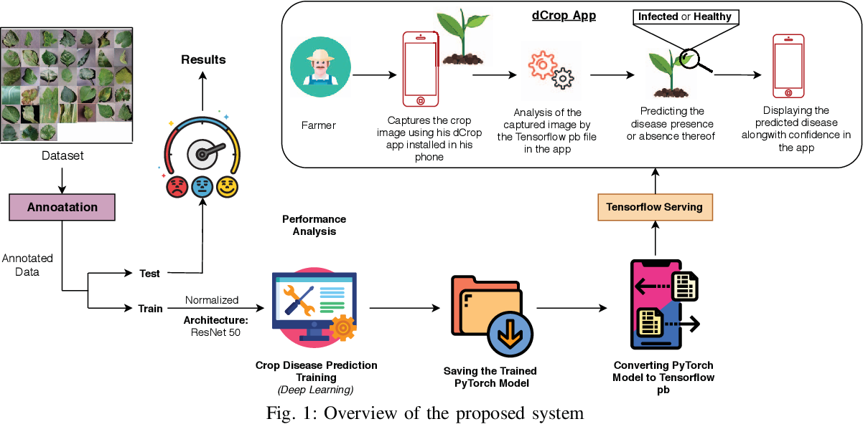
Architecture diagrams
Module1: Plant Disease Prediction

Slide 12
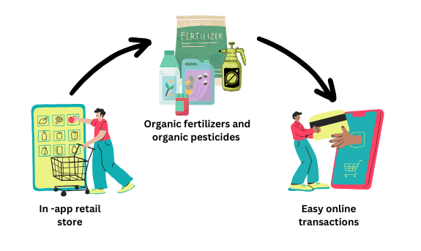
Module 2: Online retain store for organic fertilizers

Slide 13
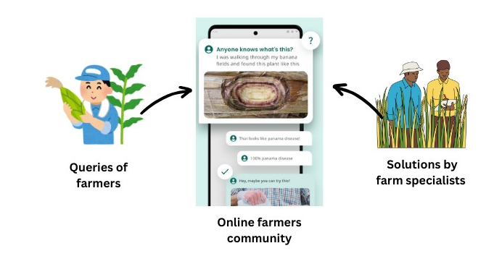
Module 3: Farmers community

Slide 14

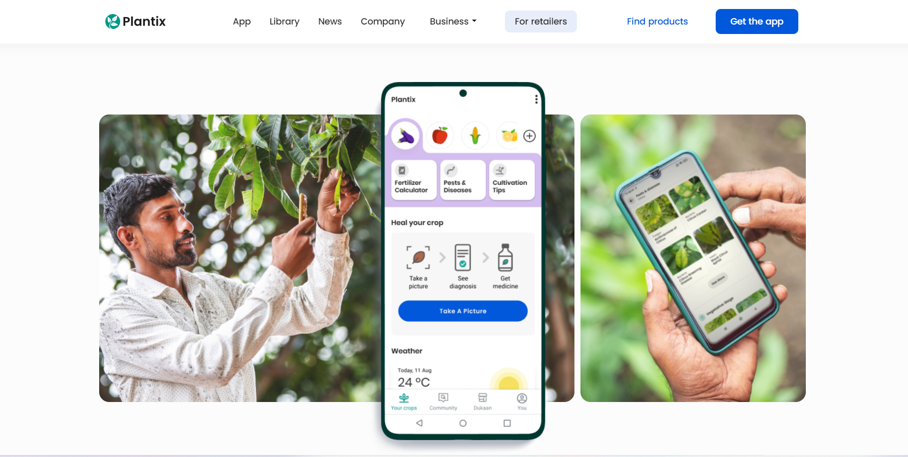
Implementation with Output

Slide 15
References
Y. Kaya and E. Gürsoy, "A novel multi-head CNN design to identify plant diseases using the fusion of RGB images", Ecol. Inform., vol. 75, pp. 101998, Jul. 2023.
A. Ahmad, D. Saraswat and A. El Gamal, "A survey on using deep learning techniques for plant disease diagnosis and recommendations for development of appropriate tools", Smart Agric. Technol., vol. 3, pp. 100083, Feb. 2023.C.
F. Khan, N. Zafar, M. N. Tahir, M. Aqib, H. Waheed and Z. Haroon, "A mobile-based system for maize plant leaf disease detection and classification using deep learning", Front. Plant Sci., vol. 14, pp. 1079366, May 2023
Apeksha Thorat, Sangeeta Kumari and Nandakishor D. Valakunde, "An IoT based smart solution for leaf disease detection", 2017 International Conference on Big Data IoT and Data Science (BID), pp. 193-198, 2020
M. Wójcik, P. Jeziorska-Biel and K. Czapiewski, "Between words: A generational discussion about farming knowledge sources", Journal of Rural Studies, vol. 67, pp. 130-141, 2019.
Chittabarni Sarkar, Deepak Gupta, Umesh Gupta and Barenya Bikash Hazarika, "Leaf disease detection using machine learning and deep learning: Review and challenges", Elsevier, vol. 145, 2023.
Sunil S. Harakannanavar, Jayashri M. Rudagi, Veena I. Puranikmath, Ayesha Siddiqua and R Pramodhini, "Plant leaf disease detection using computer vision and machine learning algorithms", ICIEA, vol. 3, no. 1, 2022.
Midhun P. Mathew and Therese Yamuna Mahesh, Leaf-based disease detection in bell pepper plant using YOLO v5, Springer, 2021.

Slide 16
THANK YOU!!!

